Slide 1


Kumar Shivam
24-Sep-2025

Slide 2

Outline
Executive Summary
Introduction
Methodology
Results
Conclusion
Appendix

Slide 3
Executive Summary
Summary of methodologies
Data Collection: SpaceX API + Wikipedia scraping
Data Wrangling: Cleaned, standardized, engineered features
EDA: SQL queries + visualizations (scatter, bar, line)
Interactive Analytics: Folium maps & Plotly Dash dashboard
Predictive Analysis: Built & evaluated ML classification models
Summary of all results
4 main launch sites identified (KSC LC-39A most reliable)
Payloads 2,000–6,000 kg → highest success rates
Success rate improved steadily over years
Interactive dashboard & maps revealed site/outcome patterns
Best Model: Logistic Regression, 83.3% accuracy

Slide 4
Introduction
Project background and context
SpaceX Falcon 9 reusability is key to reducing space launch costs
Understanding factors influencing launch success helps improve predictions & decision-making
Problems you want to find answers
Which factors (payload, site, booster, orbit) impact launch success?
How have launch outcomes changed over time?
Can we predict launch success using ML models?

Slide 5

Section 1

Slide 6
Methodology
Executive Summary
Data collection methodology:
SpaceX API & backup JSON used to fetch launch, rocket, payload, and core data.
Perform data wrangling
Fetched launch, rocket, payload, and core data from SpaceX API & backup JSON.
Flattened JSON, selected key features, filtered Falcon 9 launches, handled missing values, and extracted relevant details.
Perform exploratory data analysis (EDA) using visualization and SQL
Perform interactive visual analytics using Folium and Plotly Dash
Perform predictive analysis using classification models
Classification models to predict launch success with train-test split, feature encoding, and evaluation (Accuracy, Precision, Recall, F1, ROC-AUC).

Slide 7
Data Collection
Describe how data sets were collected.
You need to present your data collection process use key phrases and flowcharts
Start
Fetch JSON data from SpaceX API / Backup JSON
Extract Key Features: rocket, payload, cores, launchpad, date
Filter: single-core & single-payload launches
Flatten JSON -> Pandas DataFrame
Extract Booster, Payload, Orbit, Launch Site, Core Info
Clean Data: handle missing values, filter Falcon 9, reindex
End
Final Analysis-Ready DataFrame

Slide 8
Data Collection – SpaceX API
Present your data collection with SpaceX REST calls using key phrases and flowcharts
GitHub URL: https://github.com/kmrshvm/DataScienceandMachineLearningCapstoneProject/blob/main/Hands-on_Lab_Complete_the_Data_Collection_API_Lab.ipynb
Start
Call: /v4/launches/past -> Get all past launch data
Call: /v4/rockets/{id} -> Get BoosterVersion
Extract rocket IDs
Extract launchpad IDs
Call: /v4/launchpads/{id} -> Get LaunchSite, Latitude, Longitude
Extract core IDs
Call: /v4/payloads/{id} -> Get PayloadMass, Orbit
Extract payload IDs
Call: /v4/cores/{id} -> Get Block, ReusedCount, Serial
Combine results into DataFrame
End

Slide 9
Data Collection - Scraping
Present your web scraping process using key phrases and flowcharts
GitHub URL: https://github.com/kmrshvm/DataScienceandMachineLearningCapstoneProject/blob/main/Hands-on_Lab_Complete_the_Data_Collection_with_Web_Scraping_lab.ipynb
Start
Load Wikipedia Page (online)
Find Launch Table (<table>)
Create BeautifulSoup Object
Extract Column Names (<th> → extract_column_from_header)
Extract Row Data (<td> → date_time, booster_version, landing_status, get_mass)
Store in Pandas DataFrame
Export (CSV/Excel)
End

Slide 10
Data Wrangling
Describe how data were processed
You need to present your data wrangling process using key phrases and flowcharts
GitHub URL: https://github.com/kmrshvm/DataScienceandMachineLearningCapstoneProject/blob/main/Hands-on_Lab_Data_Wrangling.ipynb
Raw Data (CSV)
Load into DataFrame
Standardize Categorical Data (Outcome, Orbit)
Check Missing Values → Handle if any
Remove Irrelevant Records
Feature Engineering (landing_class)
Final Clean Dataset (ready for modeling/visualization)
Exploratory Data Analysis (counts & distributions)

Slide 11
EDA with SQL
Using bullet point format, summarize the SQL queries you performed
Unique Launch Sites → SELECT DISTINCT "Launch_Site"
First 5 Records for KSC Sites → WHERE "Launch_Site" LIKE 'KSC%' LIMIT 5
Total Payload for NASA (CRS) → SUM("Payload_Mass__kg_") WHERE "Customer" = 'NASA (CRS)'
Average Payload for F9 v1.1 → AVG("Payload_Mass__kg_") WHERE "Booster_Version" = 'F9 v1.1'
Earliest Drone Ship Landing Success → MIN("Date") WHERE "Landing_Outcome" = 'Success (drone ship)'
Boosters with Ground Pad Success & Payload 4000-6000 kg → Filter with WHERE "Landing_Outcome"='Success (ground pad)' AND "Payload_Mass__kg_" BETWEEN 4000 AND 6000
Count of Successful and Failed Missions → GROUP BY "Class" or "Mission_Outcome"
Boosters with Maximum Payload → Subquery: WHERE "Payload_Mass__kg_" = (SELECT MAX("Payload_Mass__kg_"))

Slide 12
2017 Ground Pad Success Records → Extract year/month using substr("Date", ...) and filter "Landing_Outcome"='Success (ground pad)'
Landing Outcome Counts (2010-2017) Ranked → COUNT(*) GROUP BY "Landing_Outcome" ORDER BY COUNT(*) DESC
GitHub URL: https://github.com/kmrshvm/DataScienceandMachineLearningCapstoneProject/blob/main/Hands-on_Lab_Complete_the_EDA_with_SQL.ipynb

Slide 13
EDA with Data Visualization
Summarize what charts were plotted and why you used those charts
Flight Number vs. Launch Site
Chart: Scatter-style categorical plot (catplot)
Purpose: To observe if certain launch sites have more launches and identify patterns in launch success by site.
Payload Mass vs. Launch Site
Chart: Scatter-style categorical plot (catplot)
Purpose: To see if payload mass distribution differs across launch sites and its effect on launch success.
Success Rate by Orbit Type
Chart: Bar chart (barplot)
Purpose: To evaluate which orbit types have higher or lower success rates.

Slide 14
Flight Number vs. Orbit Type
Chart: Scatter-style categorical plot (catplot)
Purpose: To explore if certain orbits are targeted at specific flight numbers and observe associated success trends.
Payload Mass vs. Orbit Type
Chart: Scatter-style categorical plot (catplot)
Purpose: To identify if payload mass affects the choice of orbit or the success rate for different orbits.
Launch Success Yearly Trend
Chart: Line chart (lineplot)
Purpose: To visualize the overall trend of launch success rates over the years and identify improvements or anomalies.
GitHub URL: https://github.com/kmrshvm/DataScienceandMachineLearningCapstoneProject/blob/main/Hands-on_Lab_Complete_the_EDA_with_Visualization.ipynb

Slide 15
Build an Interactive Map with Folium
Summarize what map objects such as markers, circles, lines, etc. you created and added to a folium map
Explain why you added those objects
Markers: Show exact launch site and NASA JSC locations.
Circles: Highlight launch site areas visually.
MarkerCluster: Group nearby launches to reduce clutter.
Colored Markers: Green = success, Red = failure for quick status view.
MousePosition: Display coordinates for points like coastline, city, highway.
PolyLine: Draw lines from launch sites to coastline/city/railway to show distance.
GitHub URL: https://github.com/kmrshvm/DataScienceandMachineLearningCapstoneProject/blob/main/Hands-on_Lab_Interactive_Visual_Analytics_with_Folium_lab.ipynb

Slide 16
Build a Dashboard with Plotly Dash
Summarize what plots/graphs and interactions you have added to a dashboard
Explain why you added those plots and interactions
Plots/Graphs Added
Line Chart
Purpose: To show trends over time (e.g., sales, user activity, or website traffic).
Reason for Adding: Helps identify patterns, seasonality, and anomalies in the data.
Bar Chart
Purpose: To compare discrete categories (e.g., revenue by region, product performance).
Reason for Adding: Makes it easy to visually compare quantities across different categories.
Pie/Donut Chart
Purpose: To show proportions or percentage contributions of categories (e.g., market share).
Reason for Adding: Quickly communicates distribution of parts within a whole.
Scatter Plot
Purpose: To show relationships between two variables (e.g., ad spend vs. sales).
Reason for Adding: Helps identify correlations, clusters, or outliers.

Slide 17
Heatmap
Purpose: To visualize intensity or frequency of data points (e.g., customer activity by time of day).
Reason for Adding: Highlights areas of high or low activity at a glance.
Map/Geospatial Plot
Purpose: To visualize geographic distribution of data (e.g., sales by region, delivery locations).
Reason for Adding: Supports location-based insights and decision-making.
Interactions Added
Dropdown Filters
Purpose: Allow users to filter data by category, date range, or region.
Reason for Adding: Makes the dashboard dynamic and user-specific, enabling focused analysis.
Hover Tooltips
Purpose: Show detailed data points on hover.
Reason for Adding: Provides context without cluttering the visual with too much information.
Zoom/Pan
Purpose: Enable users to focus on specific data ranges in time-series or spatial plots.
Reason for Adding: Improves exploration of large datasets.

Slide 18
Clickable Elements
Purpose: Allow users to drill down for detailed views (e.g., clicking a bar to see individualtransactions).
Reason for Adding: Supports interactive exploration and deeper insights.
GitHub URL: https://github.com/kmrshvm/DataScienceandMachineLearningCapstoneProject/blob/main/spacex_dash_app.py

Slide 19
Predictive Analysis (Classification)
Summarize how you built, evaluated, improved, and found the best performing classification model
You need present your model development process using key phrases and flowchart
GitHub URL: https://github.com/kmrshvm/DataScienceandMachineLearningCapstoneProject/blob/main/Hands-on_Lab_Complete_the_Machine_Learning_Prediction_lab.ipynb
Data Import
Preprocessing
Train/Test Split
Model Building
Best Model
Compare Accuracy
Evaluation
Hyperparameter Tuning

Slide 20
Results
Exploratory data analysis results
Launches mainly from 4 sites (KSC LC-39A most reliable)
Payloads 2,000–6,000 kg → highest success rate
Success rates improved steadily over the years
Orbit type influences mission outcome
Interactive analytics demo in screenshots
Folium maps: launch site locations, outcomes (success/failure), proximities
Plotly Dash dashboard: success by site, payload vs outcome, yearly trends
Predictive analysis results
ML models built to predict launch success
Best model: Logistic Regression with 83.3% accuracy
Key predictors: payload mass & booster version

Slide 21

Section 2

Slide 22
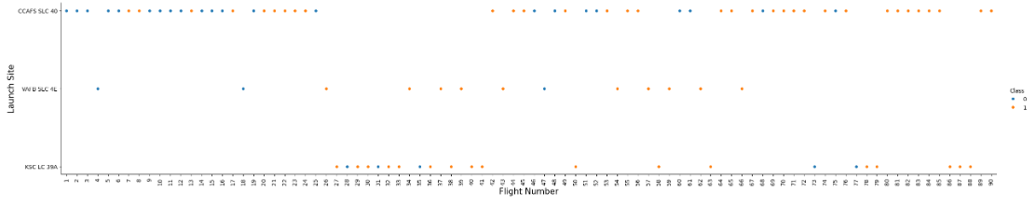
Flight Number vs. Launch Site
Show a scatter plot of Flight Number vs. Launch Site
Show the screenshot of the scatter plot with explanations
X-axis: Flight Number (each flight shown distinctly)
Y-axis: Launch Site
Point Color (Hue): Launch outcome (success/failure)
Purpose: Shows distribution of launches across sites and highlights success/failure patterns per flight

Slide 23
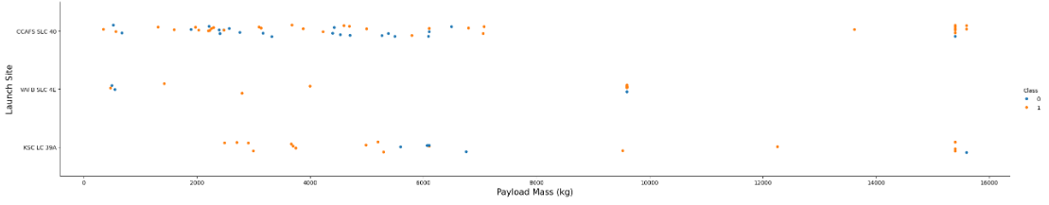
Payload vs. Launch Site
Show a scatter plot of Payload vs. Launch Site
Show the screenshot of the scatter plot with explanations
X-axis: Payload Mass (kg)
Y-axis: Launch Site
Point Color (Hue): Launch outcome (success/failure)
Purpose: Shows how payload mass varies across launch sites and its relation to launch success.

Slide 24
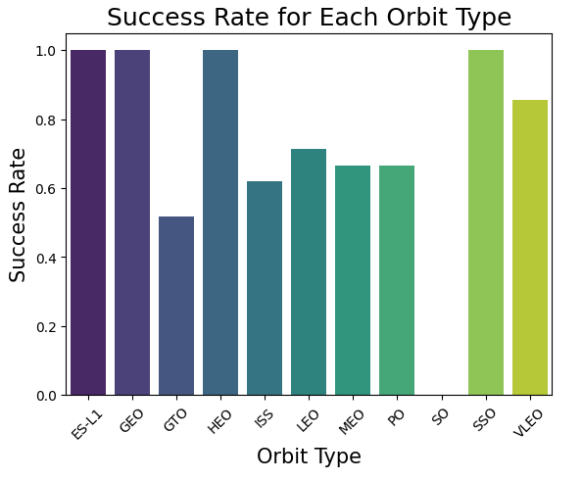
Success Rate vs. Orbit Type
Show a bar chart for the success rate of each orbit type
Show the screenshot of the scatter plot with explanations
X-axis: Orbit Type
Y-axis: Average Success Rate
Purpose: Shows which orbit types have higher or lower launch success rates.

Slide 25
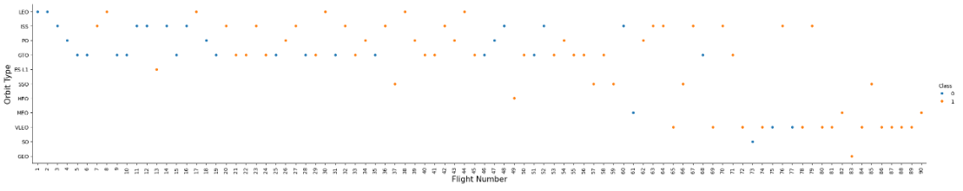
Flight Number vs. Orbit Type
Show a scatter point of Flight number vs. Orbit type
Show the screenshot of the scatter plot with explanations
X-axis: Flight Number
Y-axis: Orbit Type
Point Color (Hue): Launch outcome (success/failure)
Purpose: Shows the distribution of orbit types across flights and their success patterns.

Slide 26
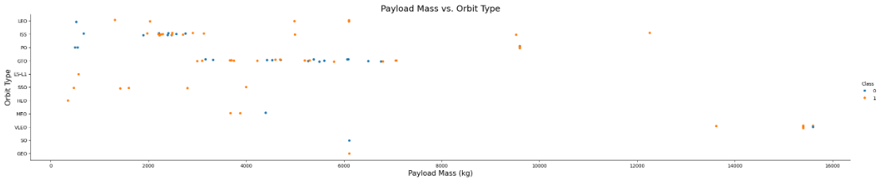
Payload vs. Orbit Type
Show a scatter point of payload vs. orbit type
Show the screenshot of the scatter plot with explanations
X-axis: Payload Mass (kg)
Y-axis: Orbit Type
Point Color (Hue): Launch outcome (success/failure)
Purpose: Shows how payload mass varies across orbit types and its relation to launch success.

Slide 27
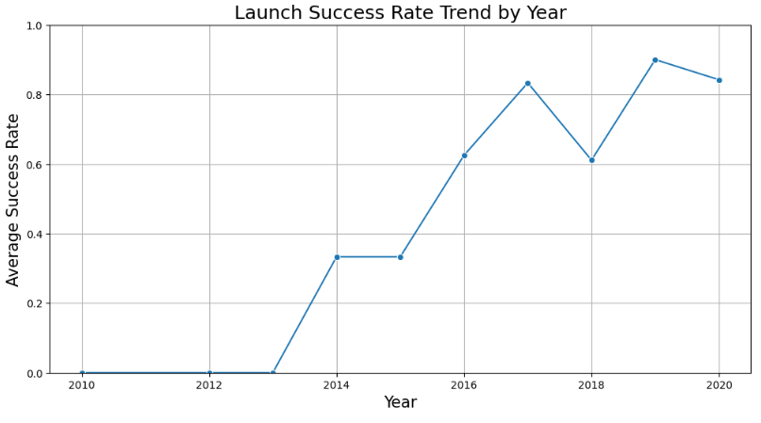
Launch Success Yearly Trend
Show a line chart of yearly average success rate
Show the screenshot of the scatter plot with explanations
X-axis: Year
Y-axis: Average Launch Success Rate
Purpose: Shows the trend of launch success over time and highlights improvements or patterns in performance.

Slide 28
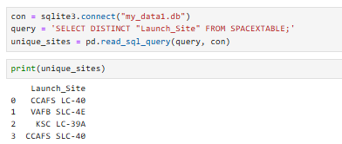
All Launch Site Names
Find the names of the unique launch sites
CCAFS LC-40
VAFB SLC-4E
KSC LC-39A
CCAFS SLC-40
Present your query result with a short explanation here
Retrieves all unique launch sites from the SpaceX dataset.
DISTINCT ensures no duplicates are shown.
Helps identify all locations where launches occurred.
Result is loaded into a pandas DataFrame for easy analysis.

Slide 29
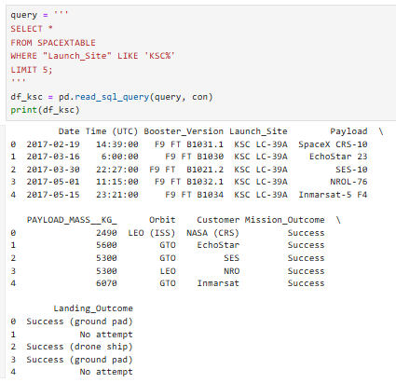
Launch Site Names Begin with 'KSC'
Find 5 records where launch sites’ names start with `KSC`
Present your query result with a short explanation here
Retrieves the first 5 records where the launch site name starts with 'KSC'.
LIKE 'KSC%' filters sites beginning with 'KSC'.
LIMIT 5 ensures only 5 rows are returned.
Useful for quickly inspecting sample data from Kennedy Space Center launches.

Slide 30
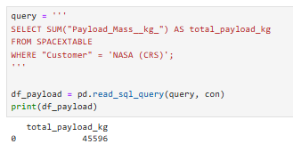
Total Payload Mass
Calculate the total payload carried by boosters from NASA
Present your query result with a short explanation here
Calculates the total payload mass carried by boosters for NASA (CRS) missions.
SUM("Payload_Mass__kg_") adds up payloads across all relevant launches.
Helps understand the overall contribution of NASA missions in terms of payload carried.

Slide 31
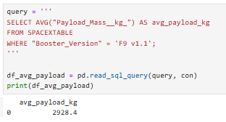
Average Payload Mass by F9 v1.1
Calculate the average payload mass carried by booster version F9 v1.1
Present your query result with a short explanation here
Calculates the average payload mass for launches using the F9 v1.1 booster.
AVG("Payload_Mass__kg_") computes the mean payload across all relevant missions.
Helps assess the typical carrying capacity of the F9 v1.1 booster.

Slide 32
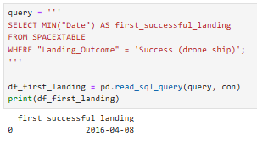
First Successful Ground Landing Date
Find the dates of the first successful landing outcome on drone ship.
Present your query result with a short explanation here
Finds the earliest date when a booster successfully landed on a drone ship.
MIN("Date") identifies the first occurrence of success.
Useful for tracking historical milestones in SpaceX drone ship landings.

Slide 33
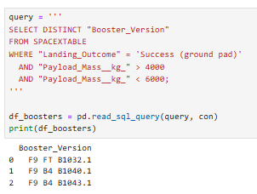
Successful Drone Ship Landing with Payload between 4000 and 6000
List the names of boosters which have successfully landed on drone ship and had payload mass greater than 4000 but less than 6000
Present your query result with a short explanation here
Lists unique booster versions that successfully landed on the ground pad.
Filters launches with payload mass between 4000 kg and 6000 kg.
Helps identify boosters that meet both performance and landing success criteria.

Slide 34
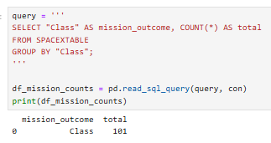
Total Number of Successful and Failure Mission Outcomes
Calculate the total number of successful and failure mission outcomes
Present your query result with a short explanation here
Counts the total number of successful and failed missions.
"Class" indicates mission outcome (1 = success, 0 = failure).
GROUP BY "Class" aggregates the counts by outcome type.
Helps summarize overall mission performance.

Slide 35
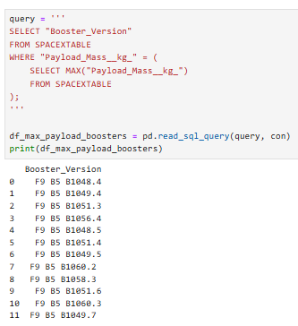
Boosters Carried Maximum Payload
List the names of the booster which have carried the maximum payload mass
Present your query result with a short explanation here
Identifies booster versions that carried the maximum payload mass.
Uses a subquery to first find the highest payload (MAX("Payload_Mass__kg_")).
Helps highlight the most capable boosters in terms of payload capacity.

Slide 36
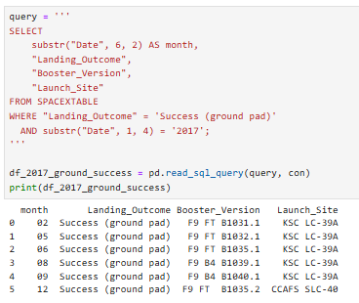
2017 Launch Records
List the records which will display the month names, succesful landing_outcomes in ground pad ,booster versions, launch_site for the months in year 2017
Present your query result with a short explanation here
Lists successful ground pad landings in the year 2017.
substr("Date", 1, 4) extracts the year; substr("Date", 6, 2) extracts the month.
Displays month, landing outcome, booster version, and launch site.
Helps analyze monthly landing performance for 2017.

Slide 37
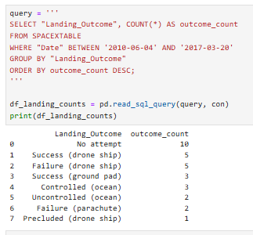
Rank Landing Outcomes Between 2010-06-04 and 2017-03-20
Rank the count of landing outcomes (such as Failure (drone ship) or Success (ground pad)) between the date 2010-06-04 and 2017-03-20, in descending order
Present your query result with a short explanation here
Counts the number of launches for each landing outcome between 2010-06-04 and 2017-03-20.
GROUP BY "Landing_Outcome" aggregates counts by outcome type.
ORDER BY outcome_count DESC ranks outcomes from most to least frequent.
Useful for analyzing success and failure trends over time.

Slide 38

Section 3

Slide 39
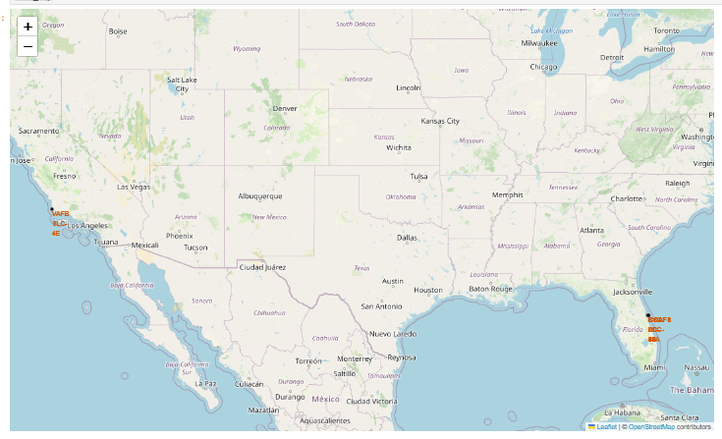
<Visualization of SpaceX Launch Sites and NASA JSC Location>
Replace <Visualization of SpaceX Launch Sites and NASA JSC Location> title with an appropriate title
Explore the generated folium map and make a proper screenshot to include all launch sites’ location markers on a global map
Explain the important elements and findings on the screenshot
NASA JSC: Orange circle with label as a reference point.
Launch Sites: Black circles with labels show all SpaceX launch locations.
Findings: Most launch sites are in the U.S.; map shows geographic spread and clusters of launches.

Slide 40
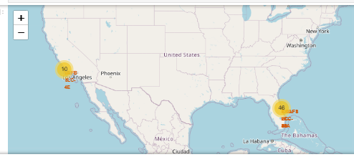
<SpaceX Launch Outcomes Visualized with Marker Clusters>
Replace <SpaceX Launch Outcomes Visualized with Marker Clusters> title with an appropriate title
Explore the folium map and make a proper screenshot to show the color-labeled launch outcomes on the map
Explain the important elements and findings on the screenshot
Marker Cluster: Groups multiple launches at the same site to reduce clutter.
Colored Markers: Green = successful launch, Red = failed launch.
Popups: Show launch site name and outcome on click.
Findings: Most launches are clustered at a few sites; visualizes success vs failure patterns clearly.

Slide 41
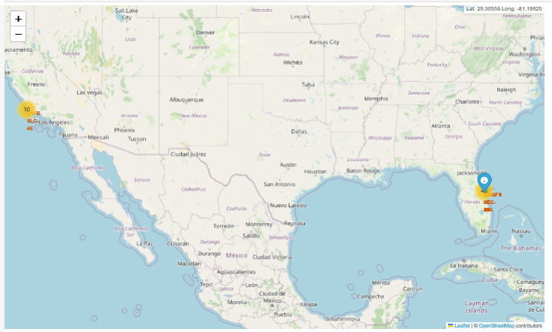
<Launch Site Proximities: Distances to Nearby Features>
Replace <Launch Site Proximities: Distances to Nearby Features> title with an appropriate title
Explore the generated folium map and show the screenshot of a selected launch site to its proximities such as railway, highway, coastline, with distance calculated and displayed
Explain the important elements and findings on the screenshot
Launch Site Marker: Shows the selected launch site location.
City Marker (Blue): Marks the closest city; popup displays distance from launch site.
PolyLine (Green, Dashed): Connects the launch site to the nearby city to visualize distance.
Distance Calculation: Uses Haversine formula to compute accurate distance in km.
Findings: Provides spatial context for launch site locations relative to nearby features like cities, coastline, highways, or railways.

Slide 42

Section 4

Slide 43
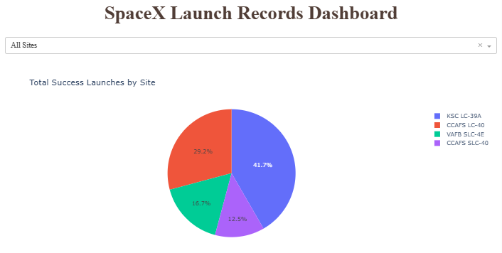
<SpaceX Launch Records Dashboard>
Replace <SpaceX Launch Records Dashboard> title with an appropriate title
Show the screenshot of launch success count for all sites, in a piechart
Explain the important elements and findings on the screenshot
Key Elements:
Segments: Each slice represents a different SpaceX launch site.
Values: Slice size shows the total number of successful launches per site.
Colors & Labels: Different colors distinguish sites; labels show launch site names.
Title: “Total Success Launches by Site” – clearly conveys the metric.
Findings:
Dominant Sites: One or two sites may account for most successful launches.
Comparison: Smaller slices indicate sites with fewer successes.
Insight: Highlights which launch sites are most reliable for successful missions.

Slide 44
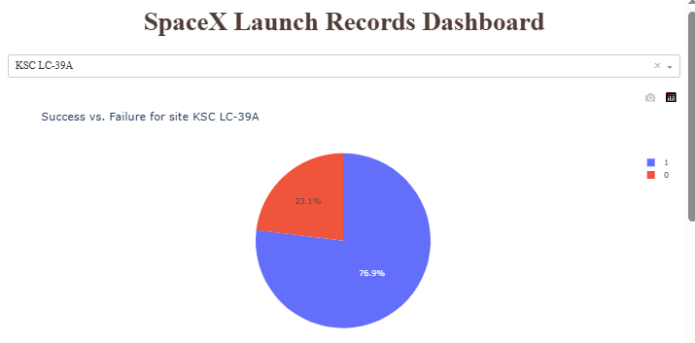
<Success vs. Failure for site KSC LC-39A>
Replace <Success vs. Failure for site KSC LC-39A> title with an appropriate title
Show the screenshot of the piechart for the launch site with highest launch success ratio
Explain the important elements and findings on the screenshot
Key Elements:
Pie chart shows Success vs Failure for the selected site.
Two slices: Successful launches vs failed launches.
Title highlights the specific launch site.
Findings:
High success ratio → majority of launches succeeded.
Few failures → indicates strong reliability at this site.
Useful for identifying the most dependable launch site.

Slide 45
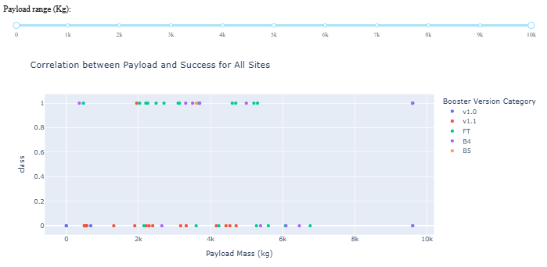
<Correlation between Payload and Success for All Sites>
Replace <Correlation between Payload and Success for All Sites> title with an appropriate title
Show screenshots of Payload vs. Launch Outcome scatter plot for all sites, with different payload selected in the range slider
Explain the important elements and findings on the screenshot, such as which payload range or booster version have the largest success rate, etc.
Key Elements:
X-axis: Payload mass (kg)
Y-axis: Launch outcome (1 = Success, 0 = Failure)
Color: Booster version category
Range slider: Filters payload window
Findings:
Most successes in the 2,000–6,000 kg payload range.
Heavier payloads show slightly lower success rates.
Certain booster versions consistently achieve higher success.
Shows correlation between payload size and reliability across sites.

Slide 46

Section 5

Slide 47
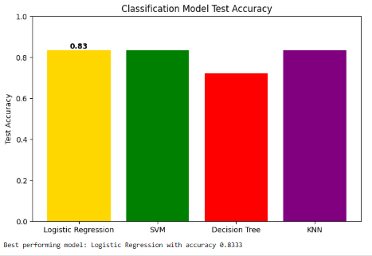
Classification Accuracy
Visualize the built model accuracy for all built classification models, in a bar chart
Find which model has the highest classification accuracy
Logistic Regression with accuracy 0.8333

Slide 48
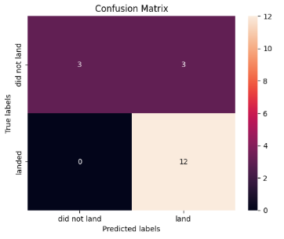
Confusion Matrix
Show the confusion matrix of the best performing model with an explanation
Best Model: Logistic Regression
Accuracy: 0.8333
Confusion Matrix:
Rows: Actual labels (Did Not Land, Landed)
Columns: Predicted labels (Did Not Land, Landed)
Diagonal: Correct predictions
Off-diagonal: Misclassifications
Purpose: Visualizes how accurately the model predicts each class.

Slide 49
Conclusions
SpaceX launch success has steadily improved over time
Payload size, orbit type, and launch site strongly influence outcomes
KSC LC-39A emerged as the most reliable site
Predictive model (Logistic Regression, 83.3% accuracy) can forecast launch success effectively

Slide 50
Appendix
Include any relevant assets like Python code snippets, SQL queries, charts, Notebook outputs, or data sets that you may have created during this project

Slide 51


